Slide 1
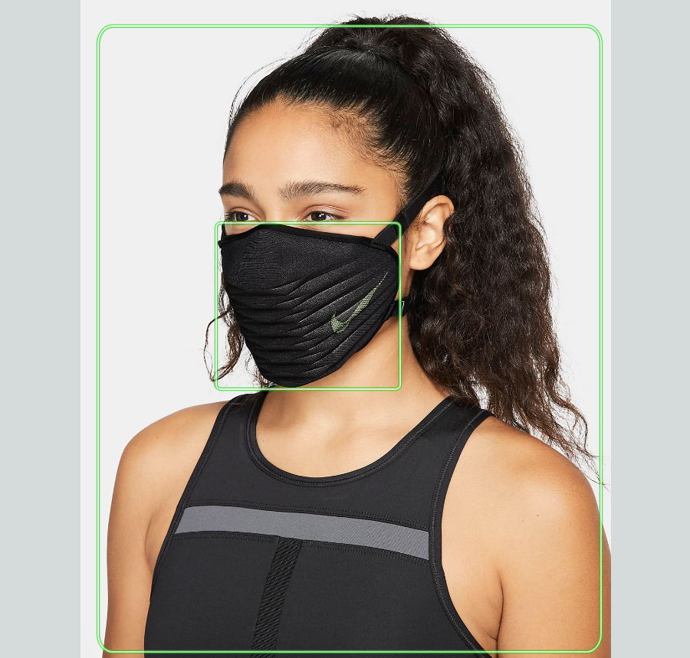
Facemask Detection
Using an IP-Camera together with AWS rekognition to detect personal protective equipment such as facemask, gloves or headcover.

Slide 2
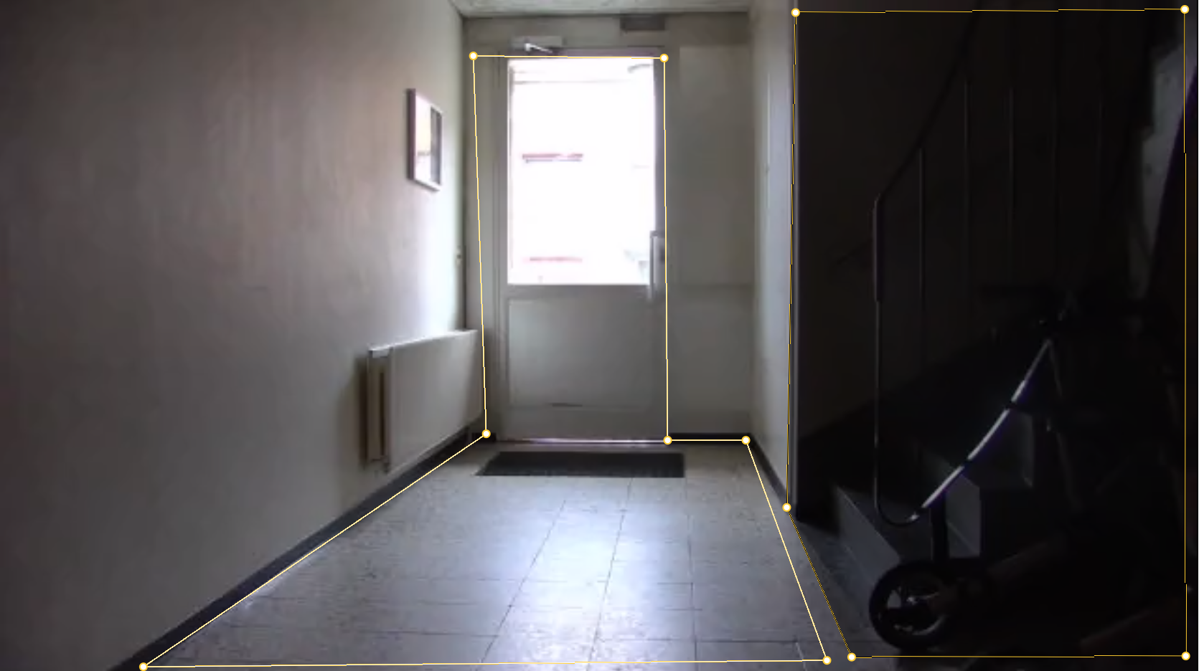
Using an IP camera with motion detection you can cover an entrance to send an alert if someone passes by.
Motions within the dark area that covers the stairs will be ignored because it is marked as an “exclusion area”.
The marked area covering the entrance will be the “include area” and will trigger an alert when someone passes by.

Slide 3
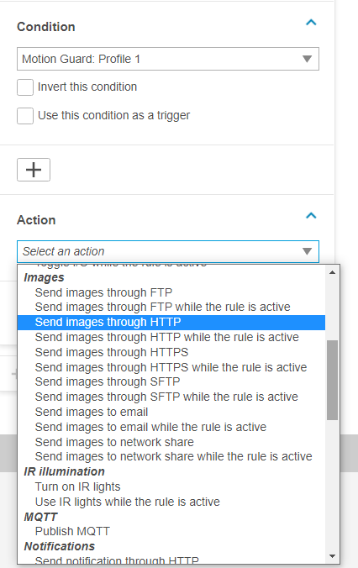
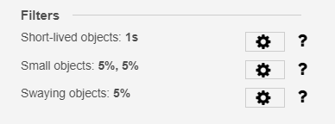
Once an alert has been triggered from the motion guard profile selected. You can choose how to send images and thereafter use AWS rekognition to detect if the person entering is using the desired personal protective equipment
You can customize settings within the include area to reduce false alarms

